Slide 1
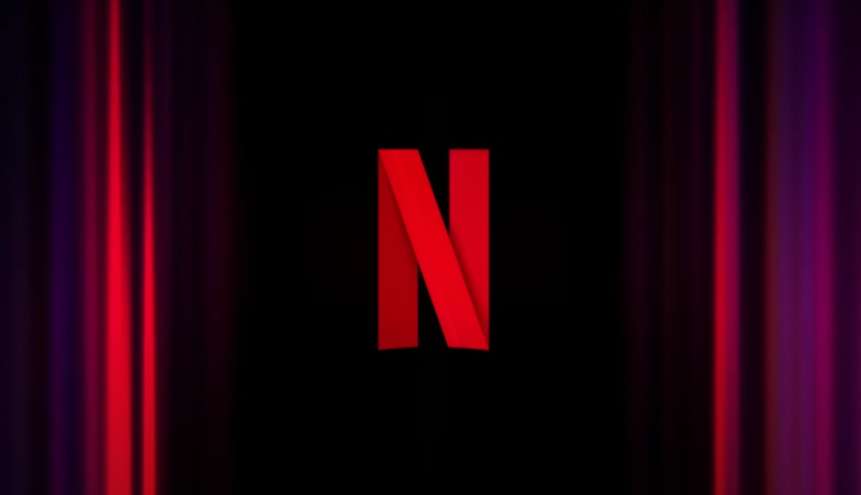
Netflix Project Report
Project Title: Exploratory Data Analysis of Netflix Titles to Uncover Content Trends and Viewer Preferences
Tools: A Comprehensive Analysis Using pandas and Power BI
Submitted by: Mumtaj
Date: [Submission Date]

Slide 2
📄 Executive Summary
This project focuses on performing a detailed data analysis of Netflix's content library using the publicly available Netflix Titles Dataset. The primary goal is to explore how the platform's content has evolved over time, identify popular genres and age ratings, and analyze contributions from countries and directors. Using Python’s Pandas and Seaborn libraries, the data was cleaned, structured, and visualized to derive meaningful insights. The analysis revealed a consistent growth in Netflix’s content offerings, especially after 2016, with a strong focus on drama, international shows, and mature-rated content. The United States and India emerged as the largest content contributors. This project provides data-driven insights to understand Netflix’s strategic content direction, helping to identify viewer demand and potential market gaps.

Slide 3
❓ Problem Statement
With the increasing competition in the OTT (Over-The-Top) streaming space, it is important to understand the content trends that drive user engagement on platforms like Netflix. However, without structured insights, it's challenging to identify what type of content is most frequently added, which genres dominate the platform, and which countries or directors contribute the most. This project addresses the need to explore and understand these patterns from Netflix's global content catalog.

Slide 4
🎯 Objective
This project is to perform an in-depth exploratory data analysis (EDA) on the Netflix Titles dataset to uncover patterns and insights related to the platform’s content offerings. The analysis aims to understand how Netflix’s content catalog has evolved over time, including trends in the number and type of shows and movies added each year. It also focuses on identifying the most common genres and analyzing the distribution of content ratings to better understand audience targeting. Additionally, the project seeks to examine the geographical diversity of the content by evaluating country-wise contributions and identifying the most frequent directors associated with Netflix content. A key part of the analysis involves detecting and visualizing outliers, especially in variables like duration, to identify unusual or extreme content entries. Overall, the objective is to draw meaningful, data-driven conclusions that can help explain Netflix’s content strategy, audience preferences, and market reach.

Slide 5
📚 About the Dataset
The dataset used for this project is titled “Netflix Movies and TV Shows”, sourced from Kaggle, and it contains information about all the titles available on Netflix as of 2021. It includes 12 key attributes for over 8,800 titles, such as show id, type (Movie or TV Show), title, director, cast, country, date added, release year, rating, duration, listed in (genres), and description. These attributes provide a comprehensive view of each title, enabling analysis from various perspectives like time-based trends, genre distribution, age suitability, and country-wise content contribution. Although the dataset is relatively clean, some fields like director, cast, and country contain missing values, which were appropriately handled during preprocessing. Overall, this dataset serves as a valuable resource for exploring Netflix’s content catalog and deriving meaningful insights through data analysis.

Slide 6
🔧 Data Cleaning and Processing
Before beginning the analysis, it was essential to clean and prepare the dataset to ensure accuracy and reliability of the results. The initial inspection revealed that while the dataset had a consistent structure, several columns contained missing values, especially in fields such as director, cast, country, rating, date added, and duration. These missing values were handled appropriately based on the nature of the data. For example, missing categorical values were either filled with placeholders like "Unknown" or left as-is if they did not affect critical insights. Column names were also standardized for readability, such as renaming listed in to genres and converting date added into a proper datetime format to enable time-based analysis.
Duplicate rows were checked and found to be absent. The duration column, which contains textual data like "90 min" or "1 Season", was processed to extract numerical values, creating a new column duration minutes for movies. Unnecessary columns such as description, which were not required for the analysis, were dropped to streamline the dataset. Outlier detection was also performed, particularly on movie durations, using the Interquartile Range (IQR) method. These outliers were visualized using boxplots, and while a few extreme values were identified, they were not removed since they represented real but rare cases. Overall, this preprocessing ensured that the dataset was clean, consistent, and ready for detailed analysis.

Slide 7
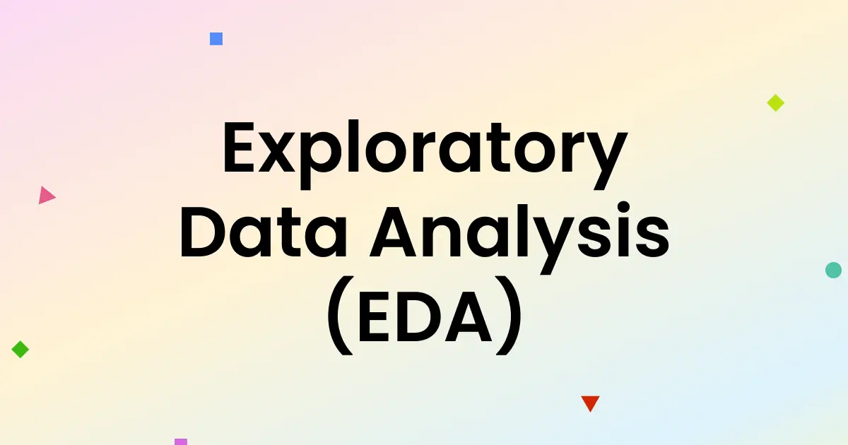
To better understand the content structure and growth trends of Netflix, various visualizations were used during the exploratory data analysis. Each chart or plot provided unique insights into a different aspect of the dataset:

Slide 8
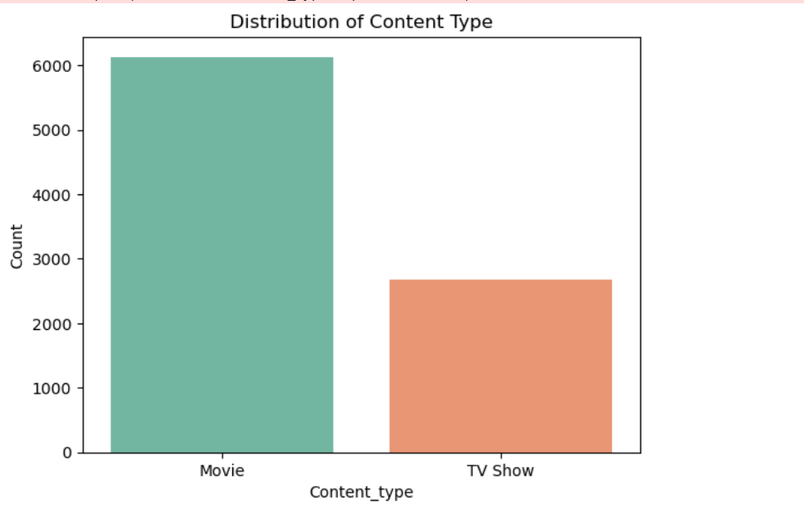
Content type distribution (movies vs TV shows) In this step, we analyzed the types of content available on Netflix. The bar chart shows that Netflix has more movies than TV shows. Out of the total content: movies make up the majority (around 6,000+ titles). TV shows are fewer, with around 2,700 titles. This shows that Netflix focuses more on movies than shows. This information helps understand the platform’s content strategy and what type of content is more common.

Slide 9
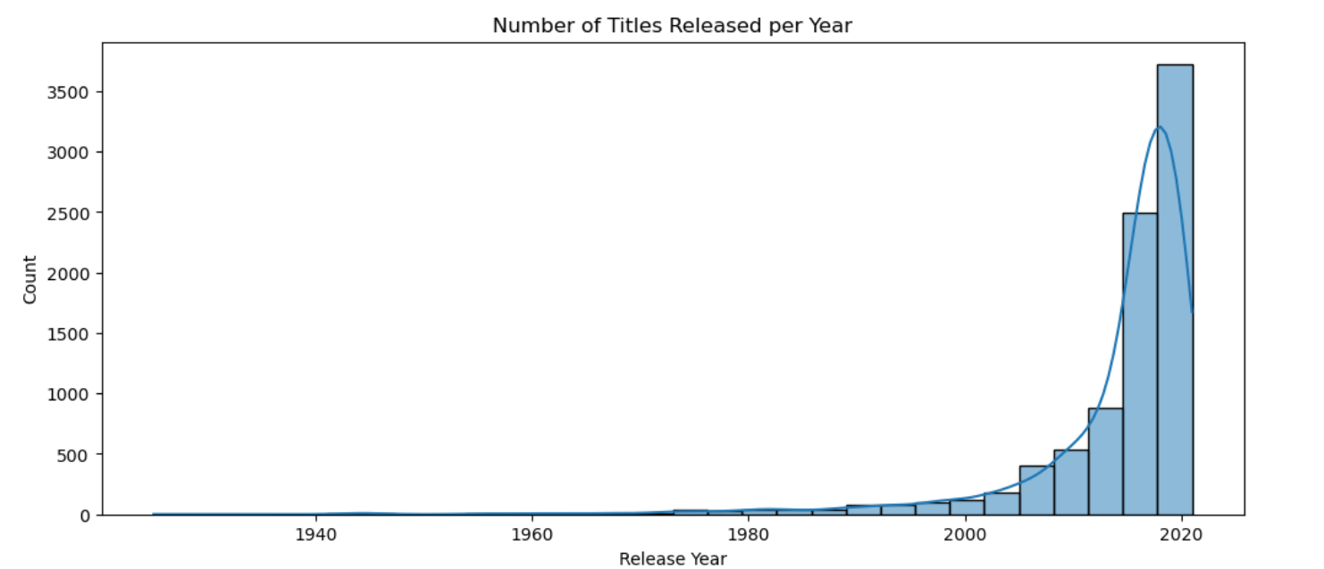
Number of titles released each year This chart shows how many shows and movies were released each year. We can see that the number of releases increased slowly until the 2000s, and then started growing rapidly. 1. The highest number of titles were released between 2015 and 2020. 2. This shows that Netflix added more new content in recent years, especially after 2015. 3. The sharp increase indicates Netflix's expansion and content growth strategy. This trend helps us understand how Netflix's content library has grown over time and how recent years have played a big role in that growth.

Slide 10
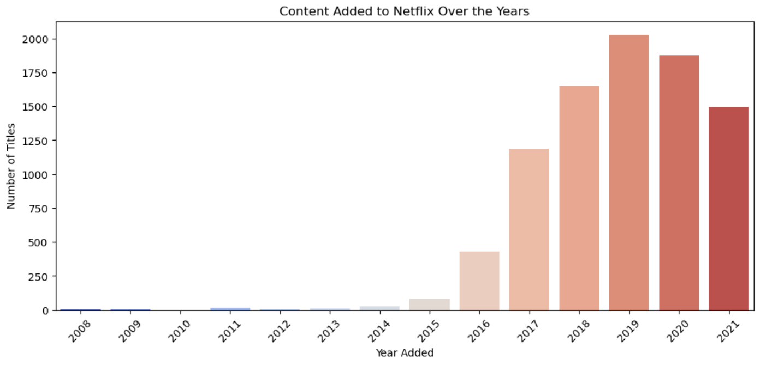
Content added to Netflix over the years This chart shows the number of titles Netflix added each year. Netflix started adding more content from around 2015, and the number kept increasing. 1. The highest number of titles were added in 2019, followed by 2020 and 2018. 2. There is a slight drop in 2021, which could be due to the pandemic or changes in content strategy. This trend clearly shows how fast Netflix expanded its library, especially between 2016 and 2020, to attract more viewers with new content.

Slide 11
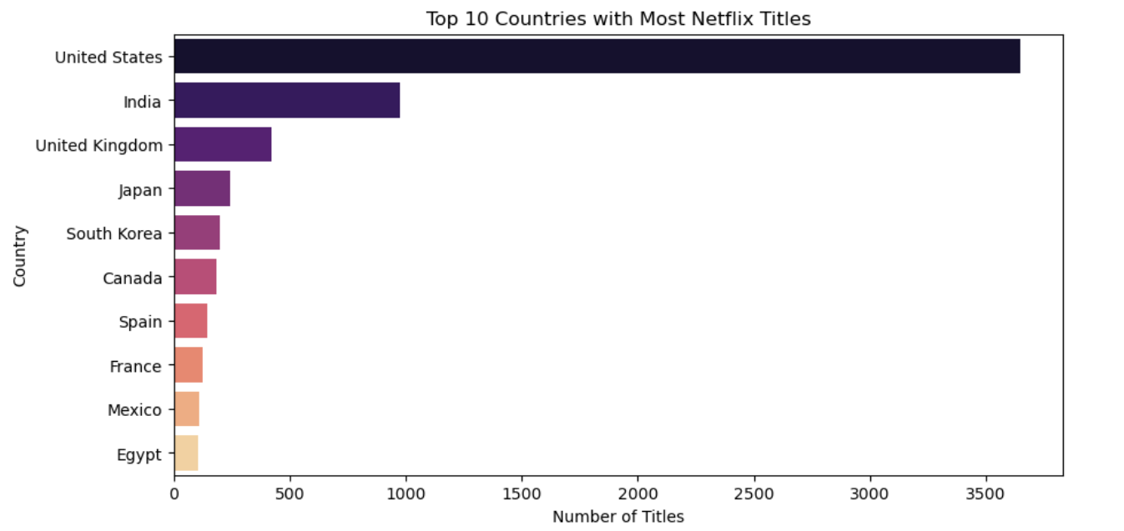
Top 10 countries with most titles This bar chart shows the top 10 countries that have the most content on Netflix. 1. The united states has the highest number of titles, followed by India and the united kingdom. 2. Other major contributors include Japan, south Korea, and Canada. 3. These countries produce a large variety of content that is available to Netflix users worldwide. This chart helps us understand which countries are the main content providers on the platform. It shows that Netflix relies heavily on content from the US and other English-speaking or high-production countries.

Slide 12
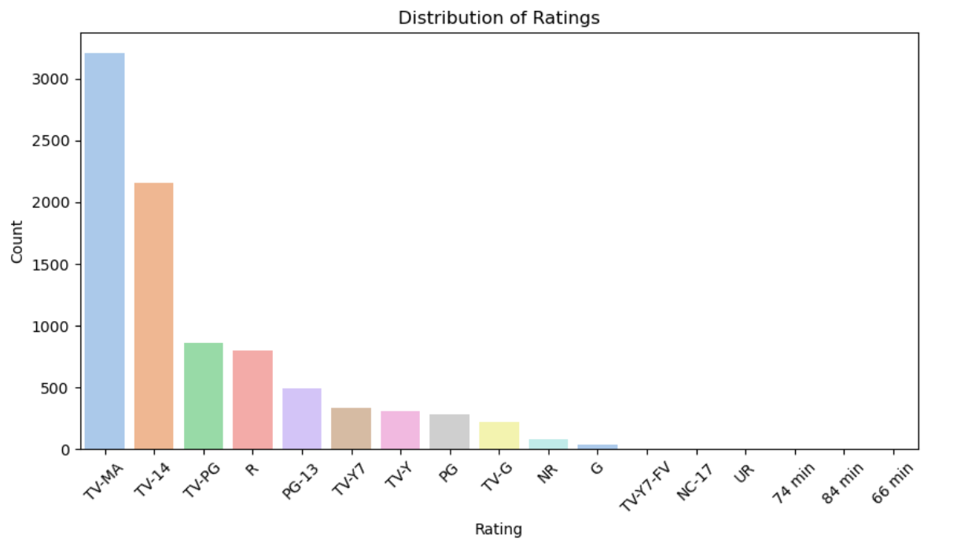
Distribution of ratings This chart shows the different content ratings used on Netflix and how often they appear. 1. The most common rating is TV-MA (for mature audiences), followed by TV-14 and TV-PG. 2. This indicates that most of the content on Netflix is made for teens and adults. 3. Ratings like G, TV-Y, and TV-G (for children) appear less frequently. This analysis helps understand the age group Netflix targets the most, which seems to be older teens and adults based on the high number of mature-rated titles.

Slide 13
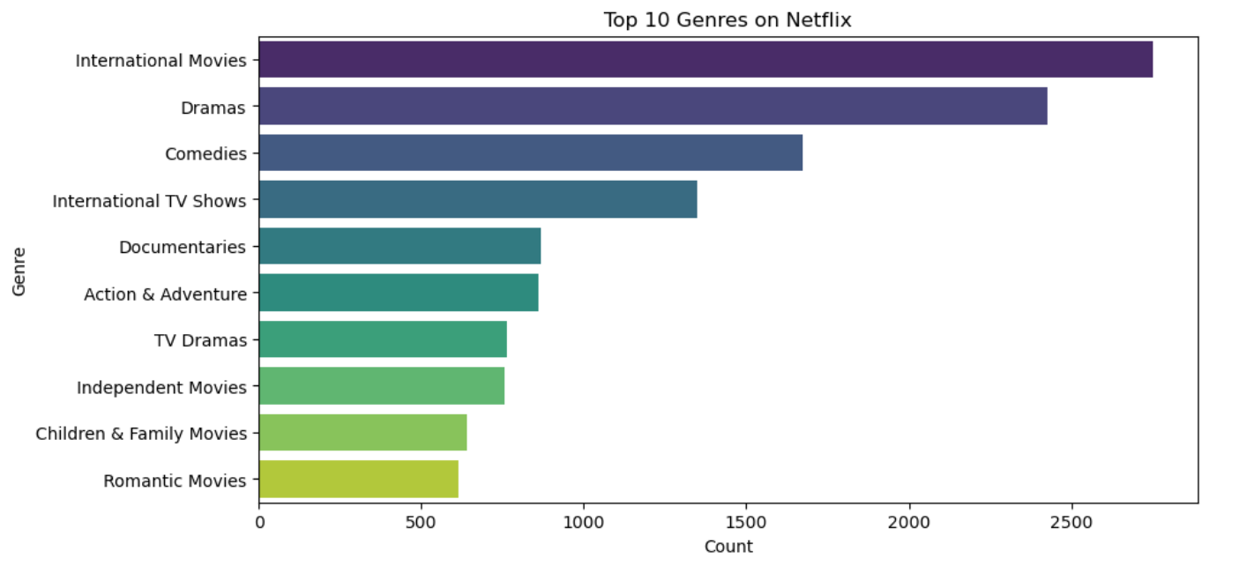
Most frequent genres This chart shows the top 10 most common genres available on Netflix. 1. The most frequent genres are international movies, dramas, and comedies. 2. Other popular genres include international TV shows, documentaries, and action & adventure. 3. This shows that Netflix offers a wide range of content, with a strong focus on drama and global content. This analysis helps us understand what kind of content is most available on Netflix, and what genres are likely preferred by viewers.

Slide 14
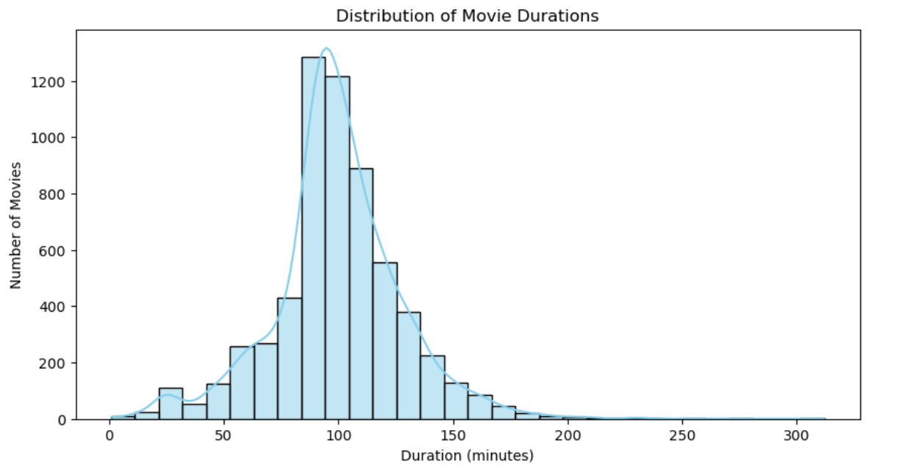
Distribution of movie durations This chart shows the length of movies available on Netflix. 1. Most movies have a duration between 80 to 120 minutes. 2. The peak is around 90 minutes, which is a standard length for most films. 3. Very few movies are shorter than 40 minutes or longer than 180 minutes. This analysis helps us understand that Netflix prefers standard-length movies, likely because they are easier to watch and fit audience preferences.

Slide 15
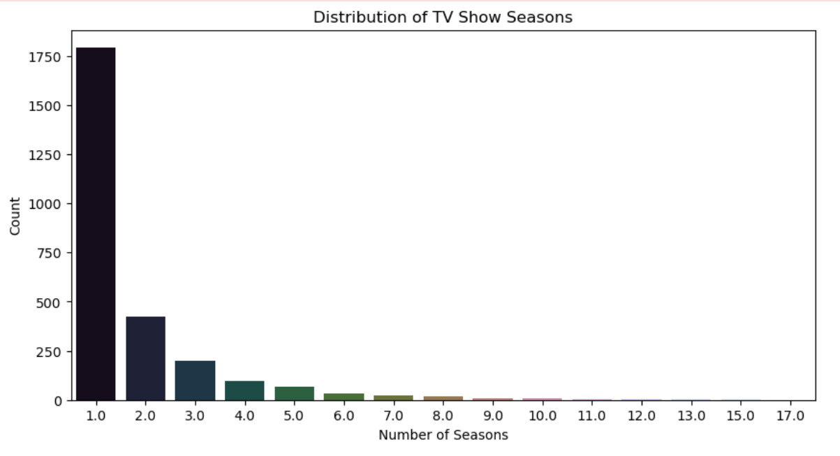
Distribution of tv show seasons This chart shows how many seasons most tv shows on Netflix have. 1. A large number of shows have only 1 season, which suggests they may be limited series or recently released. 2. Fewer shows have 2 to 5 seasons, and very few have more than 10. 3. This indicates that short TV shows are more common on Netflix than long-running ones. This insight shows that Netflix offers a lot of quick-to-watch series, which may attract viewers who prefer short and complete content.

Slide 16
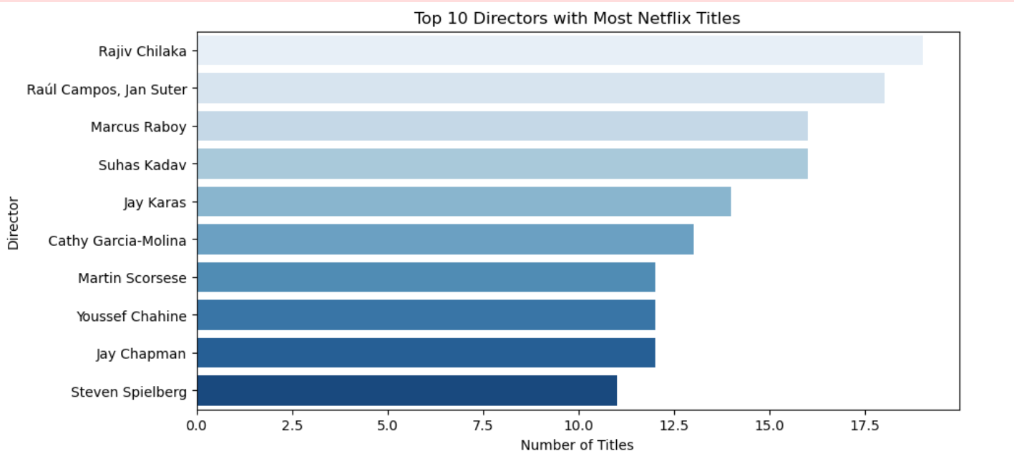
Top 10 directors with most Netflix titles This bar chart displays the directors who have the highest number of titles available on Netflix. 1. Rajiv Chilaka tops the list with the most titles, primarily known for animated children's content like Chhota bheem. 2. Raúl campos and Jan suter, often credited together, have also directed a large number of shows, many of which are comedy specials. 3. Other directors like Marcus Raboy, Suhas Kadav, and Jay Karas are also among the top, mostly contributing to comedy and children's programming. 4. Famous names such as Martin Scorsese and Steven Spielberg also appear, reflecting the presence of critically acclaimed content. This analysis highlights the most active and featured directors on the platform, showing Netflix's diverse mix of local, regional, and international content creators.

Slide 17
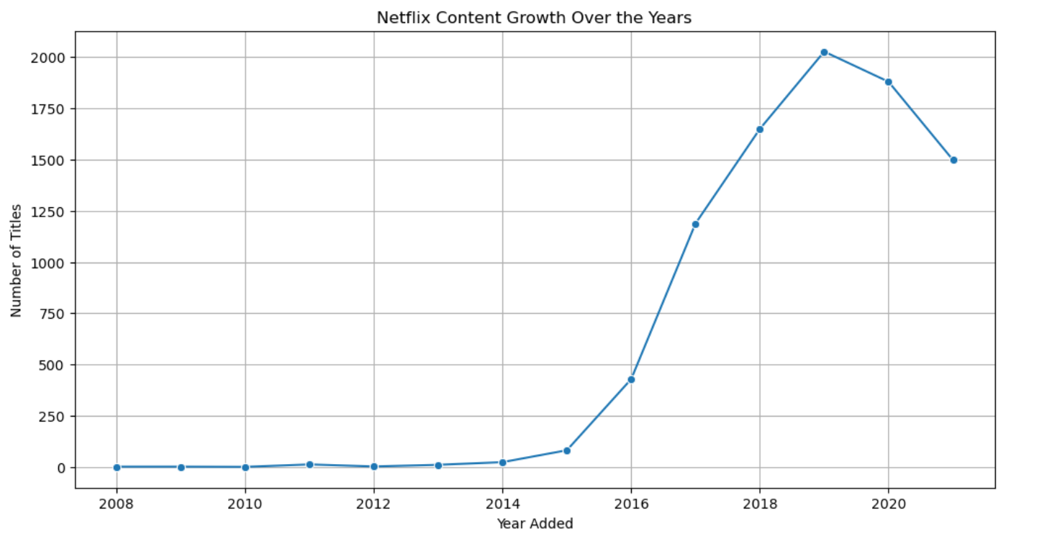
Netflix content growth over the years This chart shows how many titles were added to Netflix each year. From 2008 to 2014, growth was slow with very few titles added. Starting in 2015, content grew rapidly, peaking in 2019 with over 2000 titles. After 2019, the number of new titles dropped, possibly due to content strategy changes or the COVID-19 pandemic. This shows netflix's major expansion phase and a more selective approach in recent years.

Slide 18
✅ Conclusion In this project, we analyzed Netflix data to understand its content better. We observed that Netflix started adding more titles after 2015, with a big rise in 2018 and 2019. The united states, India, and the united kingdom are the top three countries with the highest number of shows and movies. Most of the content is rated TV-MA, which means it is suitable for mature audiences. The most popular genres on Netflix are international movies, dramas, and comedies. We also found that most movies are around 90 minutes long, and most TV shows have only one season. Directors like Rajiv chilaka and Raúl campos have directed the most titles. This analysis shows that Netflix offers a wide range of content for different audiences around the world.

Slide 19
Netflix Dashboard (Power BI) This power BI dashboard provides a visual summary of netflix's content: Total content: 8790 total shows 6127 movies 2664 TV shows Content type distribution: Movies make up around 70% of the content TV shows account for about 30% Top countries: The united states leads in both movies and TV shows, followed by the united kingdom. Top 10 genres: Stand-up comedy, TV comedies, and TV dramas are the most popular genres. Top 10 directors: Many titles have missing director data. Among known ones, Rajiv Chilaka and Alastair Fothergill appear frequently. Titles over time: Content additions peaked in 2019 and declined slightly after 2020. This dashboard gives an interactive and detailed view of Netflix's content library, helping identify trends in genres, regions, and content types.

Slide 20
